Slide 1


BCG Study case : ClientCo digital strategy
CentraleSupélec
Groupe 7
21st NOVEMBER 2022 –
2nd DECEMBer 2022

Slide 2

ClientCo state of the art Executive summary Usecases priorisation Three main usecases and roadmap Churn Prediction model
Table of contents

Slide 3
ClientCo has to start its digital transformation now to catch up with competitors
ClientCo
Competitors
BCG conducted 8 internal interviews
0,5%
CAGR
2014-2018
10,4%
100% of interviewed employees are willing to increase their use of data
The management and operational teams are not convinced of the other party’s willingness to get onboard
4,4%
ROS
2018
8,1%
CEO
Strategy
Sales
Marketing
Supply Chain
Data Team
0,2%
Long-term
Investments*
3,4%
*Mean % of total assets over the last 5 years
Source: Industry reports, brokers notes and BCG analysis

Slide 4
Executive Summary
To keep on being an international construction materials distributor, ClientCo feels the need to develop a digital strategy
- Over the last few years, ClientCo’s turnover does not follow the market evolution
- Compared to competitors, long term investments, especially in digital projects, are nearly non-existent
- Belief that a digital transformation is largely spread and welcomed among employees but not shared and there is little hope in cooperations with other teams
Among 8 usecases defined, 3 have been deepen because of their easiness of implementation, support within the team and impact on the company result
- Churn prediction model to avoid client attrition and detect whenever a risk occurs
- Recommendation tool to improve client satisfaction and meet their expectation & needs
- Data based inventories to get a clearer view of the stocks
- Implementing within 2 years those projects will enable ClientCo to launch more ambitious initiatives
To start with, implementing a churn prediction model is the most straight forward project to ensure and strengthen the digital strategy.
- + 1% in revenues could be made by retaining clients
- Profile and behavior of future churned client are similar and detecting those early signs would enable sales team to act accordingly
- Churn prediction would have made 20M€ of bonus net income in 2018

Slide 5
3 identified uses cases to begin the data journey
All employees
Focus on the quick wins to :
Deliver cash quickly and help fund the data journey
Demonstrate the value of data and get all employees onboard
Pave the way for the most impactful projects
ENABLER
Legend
Financial impact of the project
Sales
Marketing
Supply
Management
Hard
Prioritized use cases
Source : ClientCo’s Data, BCG studies

Slide 6


3 projects to develop Data culture and quickly make profits
Churn Prediction
Recommendation Tool
Data-based Inventories
Predict client attrition to enable counter measures
Advise clients according to their previous and current purchases
Enable a digital management of the warehouses
+1% income growth = +30 M€ Net
-20% client attrition
+1% Basket Growth = +30 M€ Net
50M€ Loss saved
750k€ + 250k€/year
No disturbance
750k€ + 250k€/year
No disturbance
2M€ + 500k€/year
WMS needed
Punctual warehouse disturbances
+ Paves the way for digitalized Supply Chain
Source : ClientCo’s Data, BCG studies

Slide 7
Step by step, ClientCo can enter the data era
Use Case
S1 - 2019
S2 - 2019
S1 - 2020
S2 - 2020
S1 - 2021
S2 - 2021
10 months
FTE : 712,5 k€
Follow up and continous improvement
Churn
Prediction
Scoping
Prototyping
Validation
Roll out
Digitalisation of the customer relationship
Get Marketing Team to digitally input behavorial / qualitative data
10 months
FTE : 712,5 k€
Recom-
mendation
Tool
Follow up and continous improvement
Scoping
Prototyping
Validation
Roll out
14 months
FTE : 881 k€
Data based
Inventories
Forecasted Supply Chain
Scoping
Prototyping
Validation
Roll out
Source : ClientCo’s Data and Interviews, BCG studies

Slide 8




Churn Prediction enables preventive fidelisation actions
Churn definition
Model
Customers are considered as churners when they have not bought anything for 5 months
Create client’s profile to detect the potential of churn
Find pertinent features: feature is an individual measurable property or characteristic of a phenomenon, e.g. frequency of commands
Results
What’s next ?
88% of churners detected
We have decided to detect too many customers to be sure not to miss any churners
Improve the model with more precise features: understand the customer journey, the blocking points, analyze the products, …
Implement the algorithm over all data of all stores and clients
Roll out: create automatic end-to-end pipeline to prevent churn
Source : ClientCo’s Data, BCG studies

Slide 9


In 2018, churn prediction would have made a net profit gain of 20M€
2018
100 000 churners
1/4 of customer base
840M€ of loss of sales
5,4% of total turnover
Churn prediction
algorithm
20 000 clients retained
80 000 churners
168M€ Revenue growth
+20M€ Net Income
Actions to perform to avoid client churning :
Study which signals triggers the detection
Correct bug
Tailored promotion
Call or visit client
Source : ClientCo’s Data, BCG studies

Slide 11
ClientCo organizational chart Usecases list Priorisation calculation for usecases Main usecases description Detailled roadmap Cost calculation Churn prediction model & parameters
Annex

Slide 12
Annex 1 : Organization – Interviews Made
CEO
CDO – Charlotte Davelle
Head of Strategy – Laurent Stacks
Head of Sales – Daniel Alfredo
Key Account Manager - Laura Hervé
Sales Manager - Henri Dubois
Supply Director - Tom Hammer
Fernando Suarez
Data Manager - Richard Martin
Data Engineer - Julie Clément
Commercial Director - Laure McKenzie

Slide 13
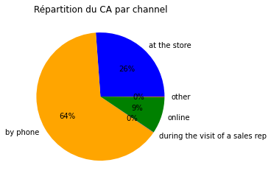
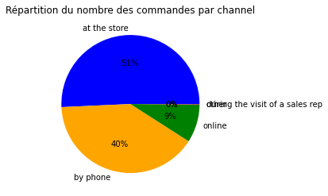
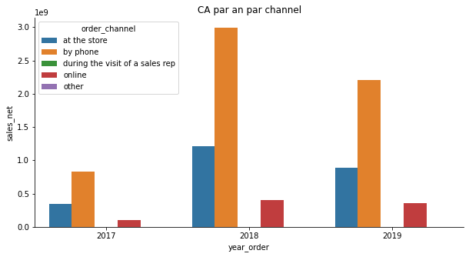
Annex 2a : Review of the company in numbers
Analyse of net sales
Analyse of channels
Repartition of net sales by channels
Repartition of commands by channels
Net sales by channels and by year

Slide 14
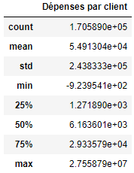
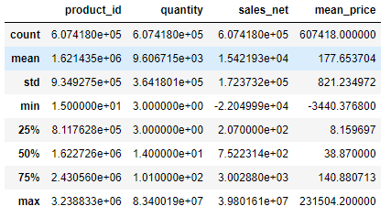
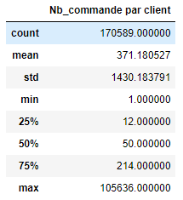
Annex 2b : Review of the company in numbers
Analyse of clients
Analyse of products
Purchases by client
Number of commands by client
Analyse of returns
424 products more returned than purchased

Slide 15




Annex 3 : List of the 8 uses cases across 4 functions
Promotion optimization - use of marketing data to improve promotions margins
Recommendation tool - advise clients according to their previous purchases, or their current purchase
Marketing
Churn prediction - predict client attrition to enable counter measures
Digitalisation of the customer relationship – digitize the sales tools to enable a digital oversight and interaction with clients
Real - time pricing – track local contexts and adapt prices to capture the best opportunities
Sales
Data-Based inventories – enable a digital management of the warehouses
Forecasted supply chain – foster anticipation capabilities to optimize the supply chain
Supply Chain
Digital management – follow and guide employees’ performance through data
Management
Those uses cases have been identified through interviews with ClientCo employees and BCG’s clients and, external researches

Slide 16

Annex 4a : Our methodology of prioritization
Impact
Priorisation
Feasability
Human
Technological
Impact
Sales
Financial
Knowledge possession
Employee approval
Investment cost
Ressources
Implementation difficulties
Available data
Workload and way of work
Production
Quality
Efficiency
Benefits
Client retention
Volume

Slide 17
Annex 4b : Calculation
# | Function | Use Case | # of sponsors | Facilité d'implémentation | Impact prévu | Impact Chiffré (en million) | Facilité (1 - easy to 6 - Hard) | Source Impact prévu
1 | Supply chain | Data-based inventories | 4 | From scracth and long Medium | Haut (plus de de OUT OF STOCK) - 50M de loss | 20 | 5 | interveiw
2 | Supply chain | Forecasted supply chain | 4 | Hard | +4 à 6 % de revenue (4% dans le calcul) | 105 | 7 | https://www.bcg.com/capabilities/operations/digital-supply-chain
3 | Sales | Churn Prediction | 7 | Easy to Medium (lack of marketing data + fear) | Medium (+1% of income) Bank : attrition = -10/15% | 31 | 2 | interview je crois
4 | Marketing | Promotion optimization | 3 | Hard (no data and require a strong ollaboration of the commercial team) | High (+ 2% in sales revenues) | 56 | 5 | interview je crois
5 | Marketing | Recommendation tool | 5 | Medium (easy to implement but no data + not supported by employees) | Medium to High (+1% in basket) | 30 | 3 | interview je crois
6 | Sales | Real time pricing | 1 | Hard (nos support, no data, very digital culture to be implemented) | +2 to 5 % in sales and +1,5% in margin (3,5% dans les calculs) | 93 | 6 | https://www.mckinsey.com/capabilities/growth-marketing-and-sales/solutions/periscope/solutions/b2b-pricing-solutions/b2b-price-optimization
7 | Sales | Digitalization of customer relationship | 1 | Medium/Hard (limitation by current CRM) + poorly supported | 3% | 81 | 3 | https://www.bcg.com/publications/2019/capturing-offline-impact-online-marketing-b2b
8 | Management | Digital management | 1 | Medium because poorly supported and will need a digital culture to be adopted but not hard technically | up to +2% of sales | 18 | 2 | pdf

Slide 18


Annex 5a : Churn Prediction : enabling preventive fidelisation actions
Description
Estimated Impact
Use of available data (sales and transactions) to predict potential customer churn and enable preventive measures.
This use case require a small task force and a pilot can be easily deployed without disturbing ongoing operations.
Mid-term ROI enabling the funding of addtionnal projects.
+1% income growth – 31 M€
Up to -20% client attrition
Required Ressources
They support it
CEO
Strategy
Sales
Marketing
Supply Chain
Data Team
“I’m not sure an algorithm could help predict it, but would be willing to try"
- Mr Dubois, Sales Manager
Sales – Transactions
Already Available
“Run” Task Force
Already Available
“This is a great use case to deploy at the beginning” – BCG former client
Scaling the program into other geographies and teaching all the local sales teams will be a challenge.
“Churn prevention is very important; it’s been a hot topic for years »
- Mr Alfredo, Head of Sales
Source : ClientCo’s Data, BCG studies

Slide 19
Annex 5b: Recommendation Tool : a tailor made offer, for each client
Description
Estimated Impact
Use the available data (previous and current purchases) on each client to suggest products to the vendors that would potentially trigger another purchase from the customer. A pilot can be easily deployed by a small team without disturbing operations.
+1% basket growth or a 31 M€ additional profit.
Short-term value creation to convince stakeholders and set a precedent for other programs.
Required Ressources
They support it
CEO
Strategy
Sales
Marketing
Supply Chain
Data Team
Transactions - Available
Behavioral/qualitative data – Not available
“I’m convinced such a tool would be efficient and the team will use it”
- Mr Dubois, Sales Manager
“Run” Task Force
Already Available
“Sales team support has been acknowledged as a great success”
– BCG former client
Marketing team don’t regularly input qualitative data. This project will require the team to gather digitally information on customers. Scaling will be challenging.
“9/10 B2B decision makers say that marketing and sales need to work more closely” - BCG Study, The futur of B2B Sales
Source : ClientCo’s Data, BCG studies

Slide 20
Annex 5c : Data based inventories : paving the way for a digital supply chain
Description
Estimated Impact
Pursue current efforts to digitize the currently manual inventories and extend capabilities of the supply chain team. Prevent out of stocks and optimize stock management through data. Set the bases to enable a forecasted supply chain.
50 M€ loss due to inventories issues or a 13M€ profit to be retained.
Long-term project to digitize a significant portion of the business.
Required Ressources
They support it
CEO
Strategy
Sales
Marketing
Supply Chain
Data Team
Real time inventory
– Not Available
WMS – Not available
Development team
- Not Available
“Run” task force
- Available
“I’m interested in a digital supply chain and convinced in the necessity to develop large scale analytics capabilities” - CEO
Will be a challenge to implement as of today there is no data at all, and everything is still very manual. Initial investment important (a WMS costs up to 250k€) and recurrent costs to be anticipated.
“Data-based inventory would be amazing ” – Mr Hammer, Supply chain director
Source : ClientCo’s Data, BCG studies, Sitaci.fr

Slide 21
Annex 6 : Detailed roadmap
Use Case
S1 - 2019
S2 - 2019
S1 - 2020
S2 - 2020
S1 - 2021
S2 - 2021
Next years …
First sales team selection
Rapid iterative & prototyping in cooperation with BCG
Process & data : uniformisation across all teams
Assess value creation
Spread and train
RUN : build internal capabilities to run project at scale
Churn
Prediction
Creation of an operating data lake
Design
Test
Adjust
Go-Live
Assess value creation & share best practice
Industrialisation of data infrastructure
Tool continuous improvement
Rapid iterative & prototyping in cooperation with BCG
Get Marketing Team to digitally input behavorial / qualitative data
Industrialisation & allocation of data infrastructure
Owner : Mr Dubois
Spread and train
Assess value creation
RUN : build internal capabilities to run project at scale
Recom-
mendation
Tool
Improve first pilot
Process & data : uniformisation across all teams
Creation of transaction data lake
Design
Test
Adjust
Go-Live
Assess value creation & share best practice
Tool continuous improvement
Perimiter definition
Subcontractor analysis
Subcontractror Development
Scale & Run
Data based
Inventories
Pilot Warehouse Selection
Input, Storage, Analysis
Partnership Agreement
Warehouse processes adaptation
Forecasted Supply Chain

Slide 22
Annex 7a : FTE needs for a 12 months deployment plan
Scoping
Prototyping
Validation
Rollout
Data scientists | 3 | 3 | 3 | 3 | 1,5 | 1,5 | 0 | 0 | 0 | 0 | 0 | 0
Deployment Leads | 3 | 3 | 3 | 3 | 3 | 3 | 0 | 0 | 0 | 0 | 0 | 0
Business Leads | 1,5 | 1,5 | 1,5 | 1,5 | 1,5 | 1,5 | 1,5 | 1,5 | 1,5 | 1,5 | 1,5 | 1,5
IT teams | 1,5 | 1,5 | 1,5 | 1,5 | 1,5 | 1,5 | 0 | 0 | 0 | 0 | 0 | 0
1 month
1 month
1 month
1 month
1 month
1 month
1 month
1 month
1 month
1 month
1 month
1 month
Average annual cost for 1 FTE: 150 k€

Slide 23
Annex 7b : Projects pricing
Projet 1 | Nb de mois | Prix
Scoping | 2 | 225000
Prototyping | 2 | 225000
Validation | 2 | 187500
Roll out | 4 | 75000
 | Total | 712500
Projet 2 | Nb de mois | Prix
Scoping | 2 | 225000
Prototyping | 2 | 225000
Validation | 2 | 187500
Roll out | 4 | 75000
 | Total | 712500
Projet 3 | Nb de mois | Prix
Scoping | 2 | 225000
Prototyping | 3 | 337500
Validation | 2 | 187500
Roll out | 7 | 131250
 | Total | 881250

Slide 24
Annex 8a :
Churn modélisation : creation of customers profiles with significant features
Customer’s regularity: frequency of commands
Commands size: Mean of net sales
Number of commands
Time for last command
Seniority
Favorite product commanded/Proportion of purchases of each products
Favorite channel/Proportion of commands in each channel
Difference of commands’ frequency between last X commands and all commands
Difference of net sales between last X commands and all commands
Number of returns in the last X commands
Difference of payment term between last X commands and all commands
Has churned
Loyalty of customers
Habits of customers
Hard to analyse all 600.000 products
Change of commands’ habits
Set X in function of the numbers of commands by clients
75% of clients have done more than 3 commands → can set x = 3
Output
Set clients that we consider as churners:
Mean Churn rate of the construction industry : 25-35%
Mean commands’ frequency : 49 days

Slide 25
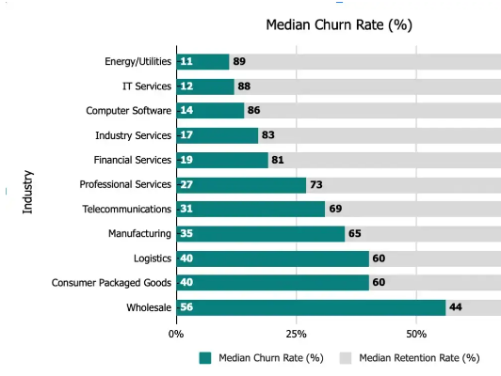
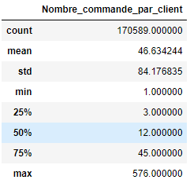
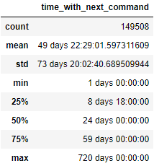
Annex 8b : Choice of parameters in the model
Choice of the number of commands for the comparisons
Choice of the number of months of silence to determine the churn
Number of commands by clients
Comparison between all the commands and the last 3
Mean frequency of 49 days. Choice of selecting the last 5 months for defining the churn (if no command for 5 months, the client has churned)
Find churn rate of 22% (ok with the median of the industry)
Source: Customergauge.com, What’s the Average Churn Rate by Industry?, Sabrina Tessitore, November 2022

Slide 26
Annex 9 : Results of all algorithms tested
 | Wei. Avg. Precision | Wei. Avg. Recall | Wei. Avg. F1-score | Explanability | Grade
Logistic Regression | 0,83 | 0,78 | 0,80 | +++ | +
Support Vector Machine | 0,86 | 0,79 | 0,80 | ++ | +
K Nearest Neighbor | 0,83 | 0,84 | 0,83 | ++ | +/-
Random Forest | 0,84 | 0,84 | 0,84 | - | -
GradientDescent Boosting | 0,85 | 0,82 | 0,83 | - | -

Slide 27
Annex 10 : Logistic Regression: significant features

